Slide 1







Select A Team
Dallas Cowboys
Houston Texans
Texas Rangers
Houston Astros
Dallas Mavericks
Houston Rockets
San Antonio Spurs

Slide 2

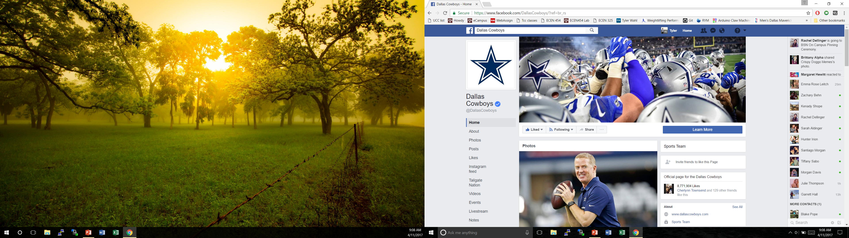

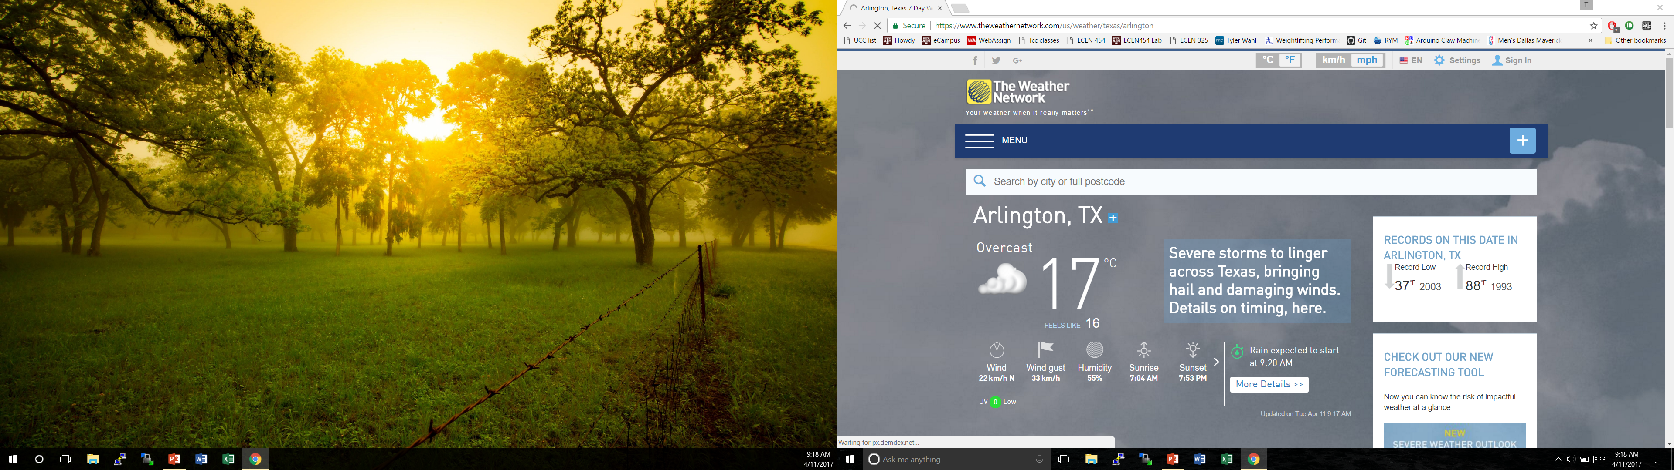
Dallas Cowboys
Roster/other Information

